Slide 1
Kelompok 2
MSS (Muroja’ah Sama-Sama)
@2019

Slide 2
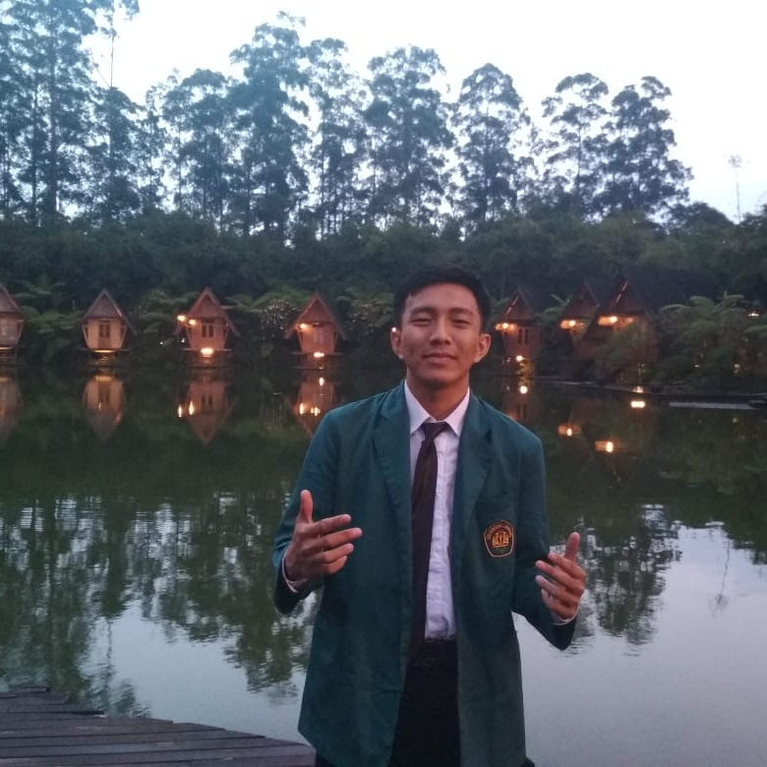
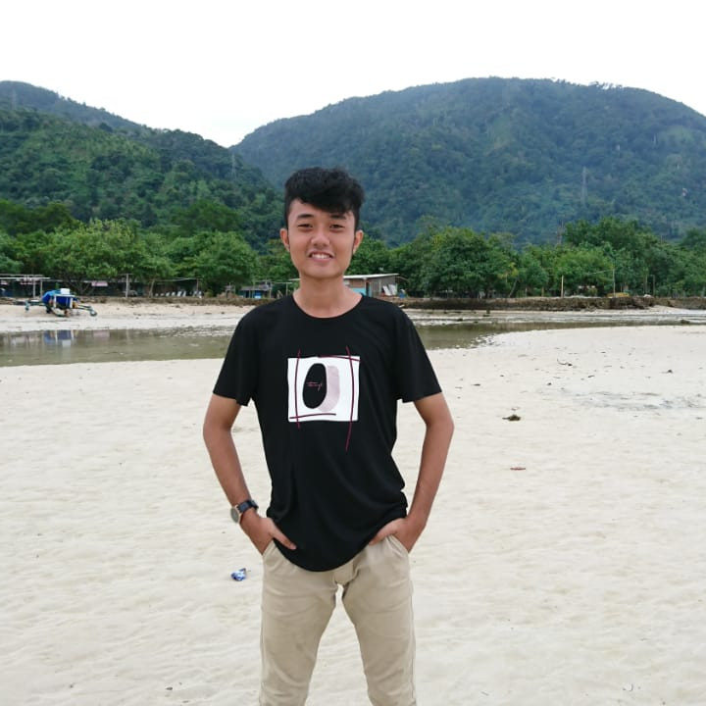
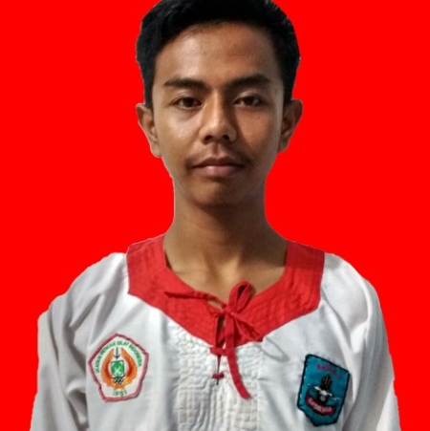

Kelompok
Enggal Alfrian
Arjuna Satrio Wibowo
Candra Maulana Aji
Mely Rahmawati

Slide 3
Deskripsi
Apa itu Aplikasi MSS atau yang dikenal dengan Muroja’ah Sama-Sama?
Apa sih keutungan yang didapatkan dengan menggunakanaplikasi ini?
Aplikasi MSS atau Muroja’ah Sama-Sama merupakan sebuah aplikasi berbasis mobile yang digunakan oleh masyarakat Indonesia dalam mengulang hafalan al-qur’an yang mereka punyai.
Keuntungan yang didapatkan yaitu berupa memudahkan pengguna dalam melakukan muroja’ah al-qur’an, memudahkan mengatur jadwal muroja’ah setiap harinya sehingga teratur dalam melakukan muroja’ah tersebut, serta adanya ustad/ustadzah yang berkompeten untuk mengoreksi hafalan al-qur’an tersebut.
Lalu, apa bedanya aplikasi MSS dengan aplikasi muroja’ah lainnya yang sudah ada?
Pada umumnya aplikasi muroja’ah yang sudah ada hanya bersifat muroja’ah saja secara mandiri tidak dilengkapi dengan fitur chatting yang mana dapat dikoreksi oleh ustad yang berkompeten dibidang tersebut serta tidak dilengkapi dengan fitur jadwal muroja’ah sehingga pengguna yang ingin muroja’ah tidak teratur dalam menjadwalkan muroja’ahnya bersama ustadz tersebut.

Slide 4
Tujuan
1. You can simply impress your audience and add a unique zing.
3. You can simply impress your audience and add a unique zing.
You can simply impress your audience and add a unique zing and appeal to your Presentations. I hope and I believe that this Template will your Time, Money and Reputation. You can simply impress your audience and add a unique zing and appeal to your Presentations.
You can simply impress your audience and add a unique zing and appeal to your Presentations. I hope and I believe that this Template will your Time, Money and Reputation. You can simply impress your audience and add a unique zing and appeal to your Presentations.
2. You can simply impress your audience and add a unique zing.
You can simply impress your audience and add a unique zing and appeal to your Presentations. I hope and I believe that this Template will your Time, Money and Reputation. You can simply impress your audience and add a unique zing and appeal to your Presentations. You can simply impress your audience and add a unique zing and appeal to your Presentations. I hope and I believe that this Template will your Time, Money and Reputation. You can simply impress your audience and add a unique zing.

Slide 5
Manfaat
1. You can simply impress your audience and add a unique zing.
3. You can simply impress your audience and add a unique zing.
You can simply impress your audience and add a unique zing and appeal to your Presentations. I hope and I believe that this Template will your Time, Money and Reputation. You can simply impress your audience and add a unique zing and appeal to your Presentations.
You can simply impress your audience and add a unique zing and appeal to your Presentations. I hope and I believe that this Template will your Time, Money and Reputation. You can simply impress your audience and add a unique zing and appeal to your Presentations.
2. You can simply impress your audience and add a unique zing.
You can simply impress your audience and add a unique zing and appeal to your Presentations. I hope and I believe that this Template will your Time, Money and Reputation. You can simply impress your audience and add a unique zing and appeal to your Presentations. You can simply impress your audience and add a unique zing and appeal to your Presentations. I hope and I believe that this Template will your Time, Money and Reputation. You can simply impress your audience and add a unique zing.

Slide 6
BATASAN SISTEM

Slide 7




Batasan Fitur
Chatting
Kegunaan :
Fitur ini digunakan untuk Get a modern PowerPoint Presentation that is beautifully designed.
Profil
Kegunaan :
Fitur ini digunakan untuk ......... PowerPoint Presentation that is beautifully designed.
Contact
Kegunaan :
Fitur ini digunakan untuk ... Get a modern PowerPoint Presentation that is beautifully designed.
Juz/Surah/Ayat
Kegunaan :
Fitur ini digunakan untuk ...... Get a modern PowerPoint Presentation that is beautifully designed.
Jadwal
Kegunaan :
Fitur ini digunakan untuk .... Get a modern PowerPoint Presentation that is beautifully designed.

Slide 8
Kebutuhan Hardware dan Software
Pada pengerjaan Aplikasi Mobile Muroja’ah Sama-sama di butuhkan kebutuhan Hardware dan Software sebagai berikut :
Hardware :
Notebook Lenovo Ideapad 320-14 AST
Processor AMD A4 4 Core (2 Core, 2 Thread) Clock Speed @2 GHz up to 2,20 Ghz, 2 MB L2 Cache
RAM 4 GB
Harddisk 500 GB
Software :
Linux Ubuntu 18.10 Mainline Kernel 5.2
Android Studio (version 3.3.2) For Llinux Amd64

Slide 9
Sasaran Pengguna
ALLPPT Layout
Clean Text Slide for your Presentation
You can simply impress your audience and add a unique zing and appeal to your Presentations. Get a modern PowerPoint Presentation that is beautifully designed. I hope and I believe that this Template will your Time, Money and Reputation.

Slide 10
Methodology
Content Here
Content Here
Content Here
You can simply impress your audience and add a unique zing and appeal to your Reports.
You can simply impress your audience and add a unique zing and appeal to your Reports.
You can simply impress your audience and add a unique zing and appeal to your Reports.
1
2
3
4
5
6
Content Here
Content Here
Content Here
You can simply impress your audience and add a unique zing and appeal to your Reports.
You can simply impress your audience and add a unique zing and appeal to your Reports.
You can simply impress your audience and add a unique zing and appeal to your Reports.

Slide 11
Timeline Pengerjaan
Contents
Contents
You can simply impress your audience and add a unique zing and appeal to your Presentations.
Contents
You can simply impress your audience and add a unique zing and appeal to your Presentations.
Contents
You can simply impress your audience and add a unique zing and appeal to your Presentations.
You can simply impress your audience and add a unique zing and appeal to your Presentations.
Bulan Ke-1
Bulan Ke-2
Bulan Ke-3
Bulan Ke-4
Bulan Ke-5

Slide 12
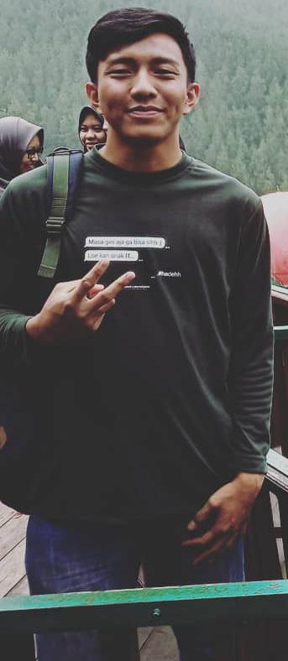
Work Experience
Progress Company
2013 ~ 2014 Text here
Example Text : Get a modern PowerPoint Presentation that is beautifully designed.
2015 ~ 2016Text here
Example Text : Get a modern PowerPoint Presentation that is beautifully designed
Presentation
Presentation
Presentation
Presentation
2016 ~ 2019 Text here
Example Text : Get a modern PowerPoint Presentation that is beautifully designed.
Java– 70%
Add Skills – 80%
Add Skills – 60%
Enggal Alfrian
Add Skills – 90%

Slide 13
Pembagian Tugas
Work Experience
Progress Company
2013 ~ 2014 Text here
Example Text : Get a modern PowerPoint Presentation that is beautifully designed.
2015 ~ 2016Text here
Example Text : Get a modern PowerPoint Presentation that is beautifully designed
Presentation
Presentation
Presentation
Presentation
2016 ~ 2019 Text here
Example Text : Get a modern PowerPoint Presentation that is beautifully designed.
Java– 70%
Add Skills – 80%
Add Skills – 60%
Name Here
Add Skills – 90%

Slide 14
Pembagian Tugas
Work Experience
Progress Company
2013 ~ 2014 Text here
Example Text : Get a modern PowerPoint Presentation that is beautifully designed.
2015 ~ 2016Text here
Example Text : Get a modern PowerPoint Presentation that is beautifully designed
Presentation
Presentation
Presentation
Presentation
2016 ~ 2019 Text here
Example Text : Get a modern PowerPoint Presentation that is beautifully designed.
Java– 70%
Add Skills – 80%
Add Skills – 60%
Name Here
Add Skills – 90%

Slide 15
Pembagian Tugas
Work Experience
Progress Company
2013 ~ 2014 Text here
Example Text : Get a modern PowerPoint Presentation that is beautifully designed.
2015 ~ 2016Text here
Example Text : Get a modern PowerPoint Presentation that is beautifully designed
Presentation
Presentation
Presentation
Presentation
2016 ~ 2019 Text here
Example Text : Get a modern PowerPoint Presentation that is beautifully designed.
Java– 70%
Add Skills – 80%
Add Skills – 60%
Name Here
Add Skills – 90%

Slide 16
Mockup Aplikasi
MSS (Muroja’ah Sama-Sama)

Slide 17
Mockup Aplikasi
MSS (Muroja’ah Sama-Sama)

Slide 18
Mockup Aplikasi
MSS (Muroja’ah Sama-Sama)

Slide 19
Mockup Aplikasi
MSS (Muroja’ah Sama-Sama)

Slide 20
Mockup Aplikasi
MSS (Muroja’ah Sama-Sama)

Slide 21
Mockup Aplikasi
MSS (Muroja’ah Sama-Sama)

Slide 22
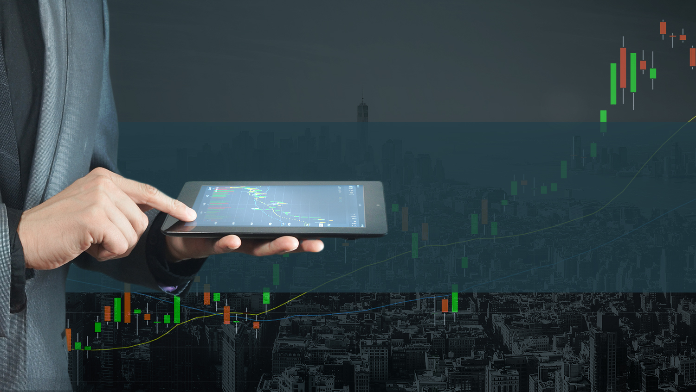
Thank You
Salam Hangat Dari Kami.

